Slide 1
JIRA
Gayathri R
April 2020

Slide 2

Agenda
JIRA – An Introduction
Why JIRA?
Key Capabilities of JIRA
Key Benefits
Software / Hardware Requirements
Demo

Slide 3





JIRA – An Introduction
Jira is a proprietary web based issue tracking product that allows Issue / bug tracking and Agile Project Management.
Originally, Jira was designed as a bug and issue tracker. Later, Jira evolved into a powerful work management tool for all kinds of use cases, from requirements and test case management to Agile software development.
Developed by Atlassian an Australian Company with Headquarters in Sydney
Written in Java;
JIRA is multi-lingual tool – English (US, UK, India), French, German, Portuguese, Spanish, Korean, Japanese and Russian.
JIRA is available as a Mobile Application as well. It is available on Google Play Store and App Store (iTunes) of Apple.
Initial release: 2002
Stable release: 8.8.0 (March 9, 2020)

Slide 4
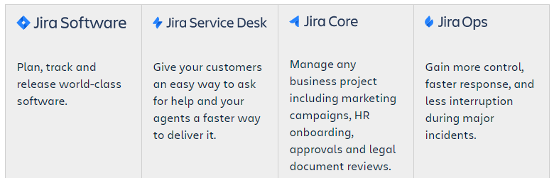
JIRA – An Introduction
Target Users
Software Developers, Project Managers and Scrum Masters
Issue / Bug tracking, Project / Product / Process management, Task management, Agile software development – Scrum & Kanban boards, customizable workflows, progress reports, Estimation & time logging, Access control, notifications, Reports & Analytics.
Capabilities
Key Integrations
Confluence, Bitbucket, Slack, GitHub, Zephyr, TFS, Subversion, CVS etc.,

Slide 5






Why JIRA ?
Flexible planning
Scrum, Kanban or Mixed methodology. Jira Software’s rich planning features enable your team to flexibly plan in a way that works best for them.
Accurate estimations
Estimations help your team become more accurate and efficient. Use story points, hours, t-shirt sizes, or your own estimation technique. Jira Software supports them all.
Value-driven prioritization
Manage user stories, issues, and bugs in your product backlog with simple drag and drop prioritization. Ensure stories that deliver the most customer value are always at the top.
Transparent execution
Cross Functional team? - Jira Software brings a new level of transparency to your team's work and keeps everyone on the same page
Actionable results
Extensive reporting functionality gives your team critical insight into their agile process. Backed by data, retrospectives are more data-driven and actionable than ever before.
Scalable evolution
Add and change issue types, fields, and workflows as your team evolves. Jira Software is agile project management designed for teams of every shape and size.

Slide 6
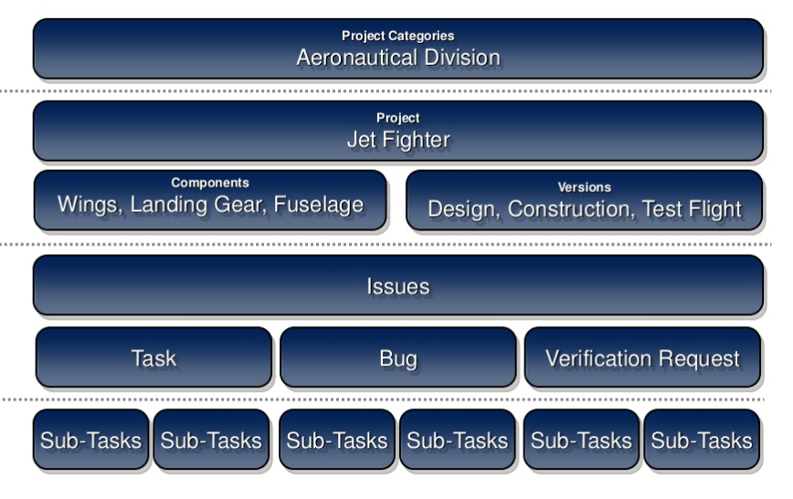
JIRA – Key Capabilities
Project Categories help team view work across related projects; It is not a project hierarchy
Project is a collection of Issues to manage across the application lifecycle.
Components are sub sections of Project. To Group issues within smaller parts
Versions are points-in-time for a project. They help in scheduling and organizing the releases.
Issues are building blocks in JIRA. Issue could be a Story, Bug, Task etc.,
Sub task is a division of parent Issue.. A sub task can be assigned and tracked individually.

Slide 7
JIRA – Key Capabilities – JIRA Project
Project Creation: A project is simply a collection of issues (stories, bugs, tasks, etc). A project can represent the development work for a product, project, or service in Jira Software.
JIRA Project has two templates
Classic Template
Scrum
Kanban
Bug Tracking
Next-Gen Template
Scrum
Kanban
Best for..
Controlling consistency across many teams and projects
Teams needing the full functionality and configuration of classic JIRA
Has Advanced configuration, config shared across multiple proj, multiple boards & cross project boards, 20 diff reports and version mgmt.,
Expert Configuration & Detailed permission
Story point & Time estimation
Best for..
Running proj automatically without JIRA Admin
Teams wanting a simpler experience
Has Streamlined configuration, simple workflows, Per-Proj configuration, single board per project, burnup and velocity reports
Light weight configuration
Simplified Permission
Story point estimation only.

Slide 8
JIRA – Key Capabilities – JIRA Project
Configure the board for your project: Board is the central tool for working with issues in JIRA Project. You can configure the following types of board to your project
Scrum
Kanban
Bug Tracking
Scrum has an iteration-based approach, which is generally a good fit for teams developing products, particularly if your team is releasing new versions on a regular schedule.
Kanban is better suited for a continuous flow of work (e.g. service-oriented teams), where its constraint-based approach helps prevent your team from being overloaded.
Bug tracking delivers a basic workflow for tracking new features and bugs.
Configure Issue Types, Workflow and Permissions

Slide 9
Project Setup

Slide 10
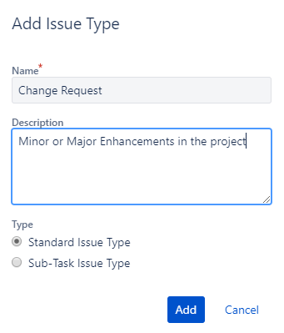
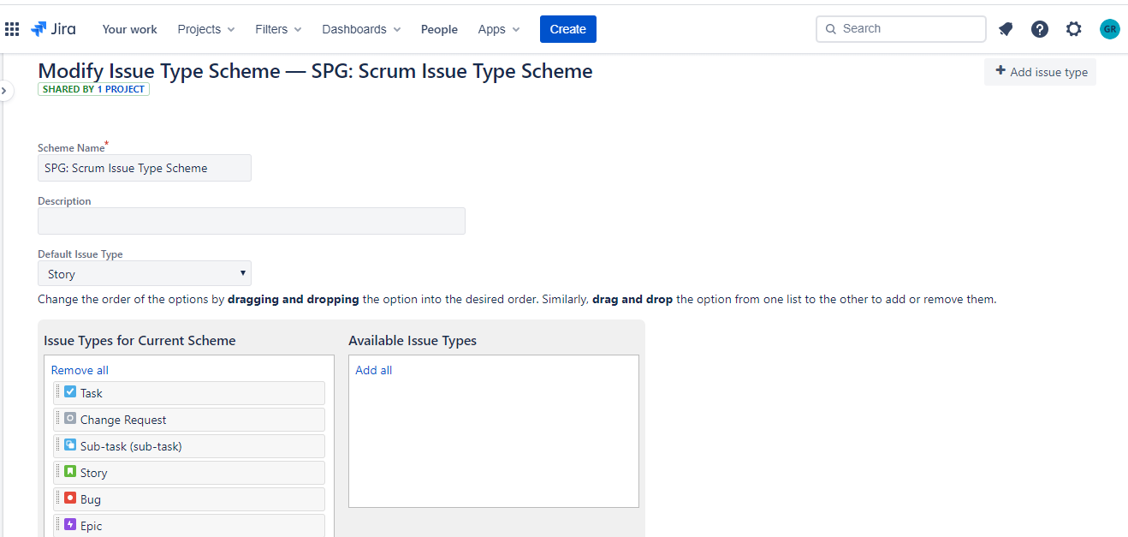
JIRA – Key Capabilities – Configure Issue Types
Select “Project Settings” menu from left pane, Then select Issue Type → Edit Issue Type option to view, add and edit Issue Types.
User can also configure the issue types needed for the project

Slide 11
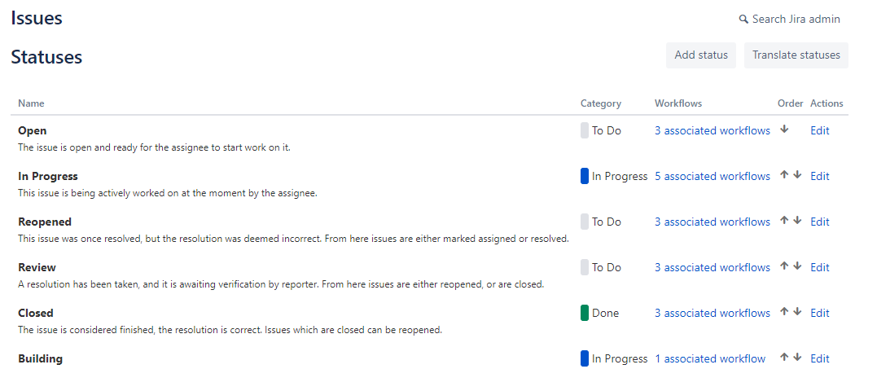
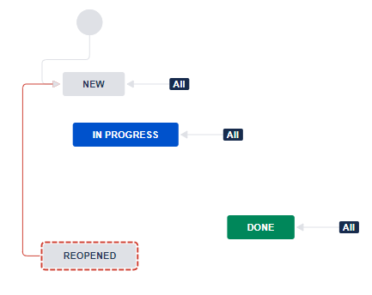
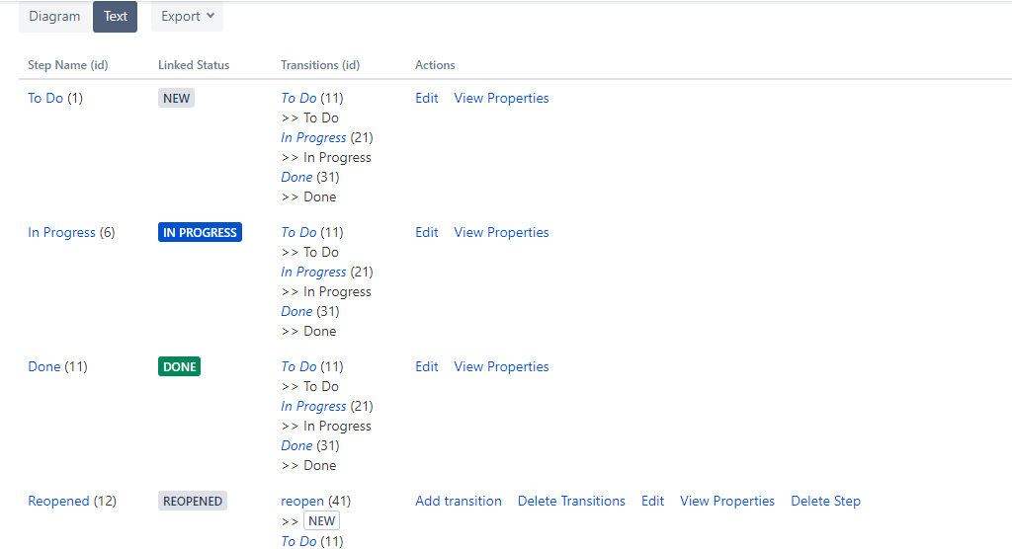
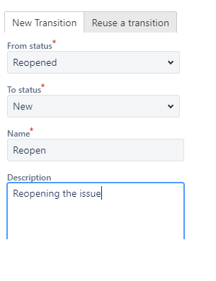
JIRA – Key Capabilities – Configure Status and Workflows
Configure Custom status by navigating to Project Settings → Status menu
Configure Custom status can be added to the workflow of any issue type either via text or diagrammatically by establishing the transition

Slide 12
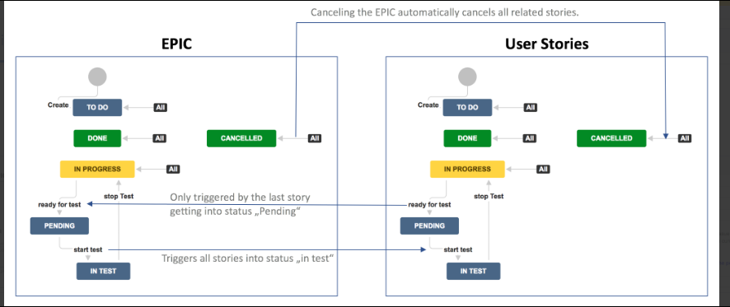
JIRA – Key Capabilities – Workflow
Workflow is very powerful and highly configurable that even a complex workflow can be configured in JIRA.

Slide 13
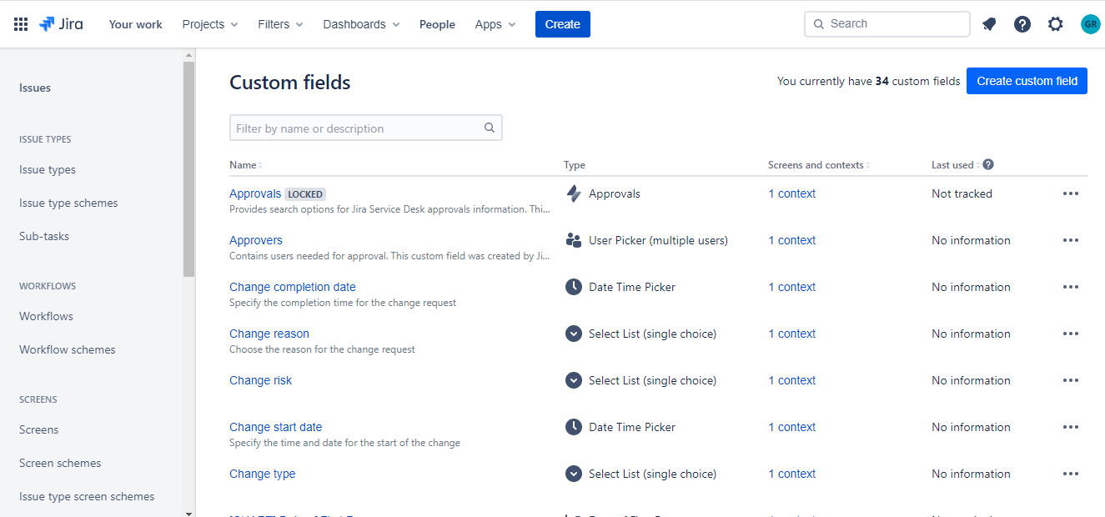
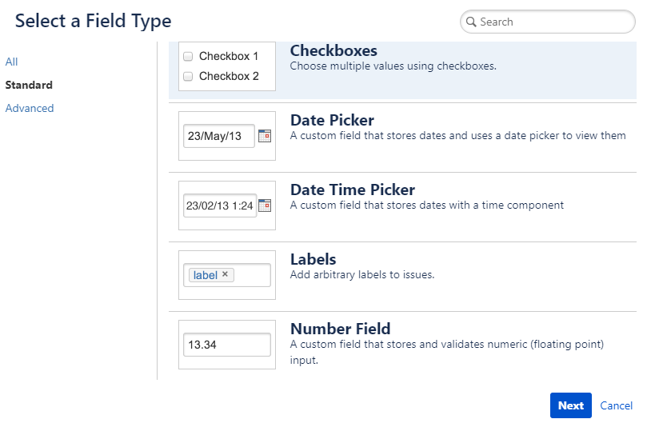
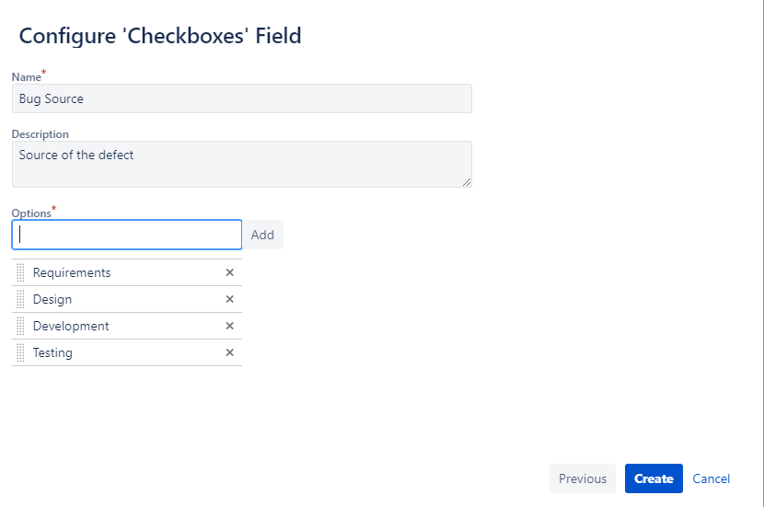
JIRA – Key Capabilities – Attribute Configuration
1
Navigate to Project Settings → Custom Fields option
Select “Create Custom Field” Button.
3
Provide the field details and create the same.
2
Select the field type

Slide 14
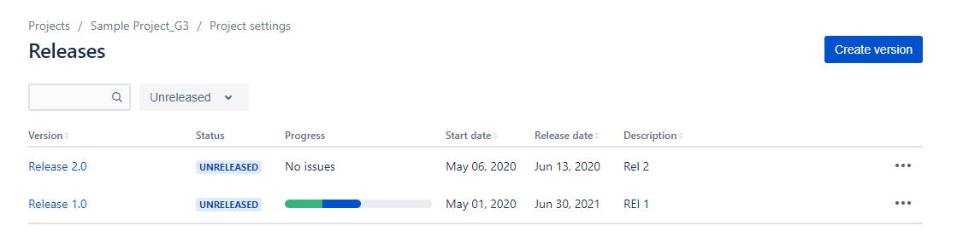
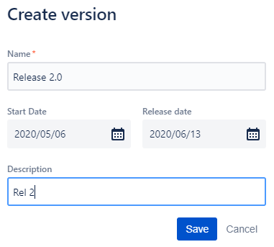
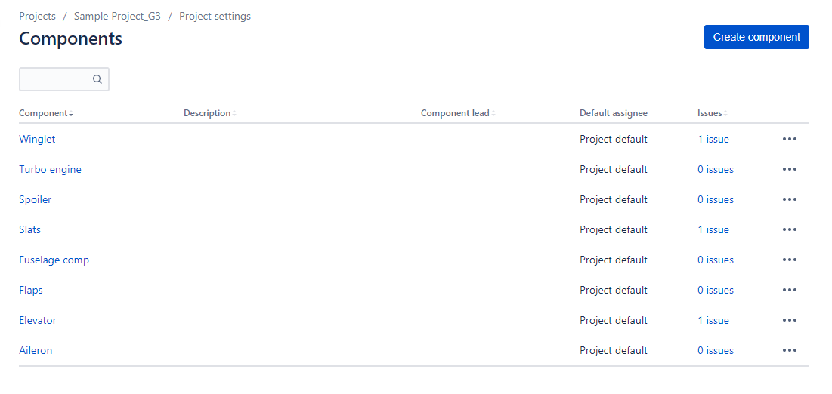
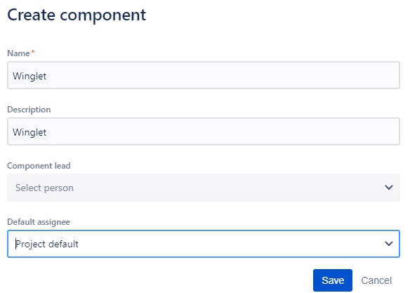
JIRA – Key Capabilities – Version/Component Creation
Navigate to Project Settings → Versions and Components menu to create project specific components and versions

Slide 15
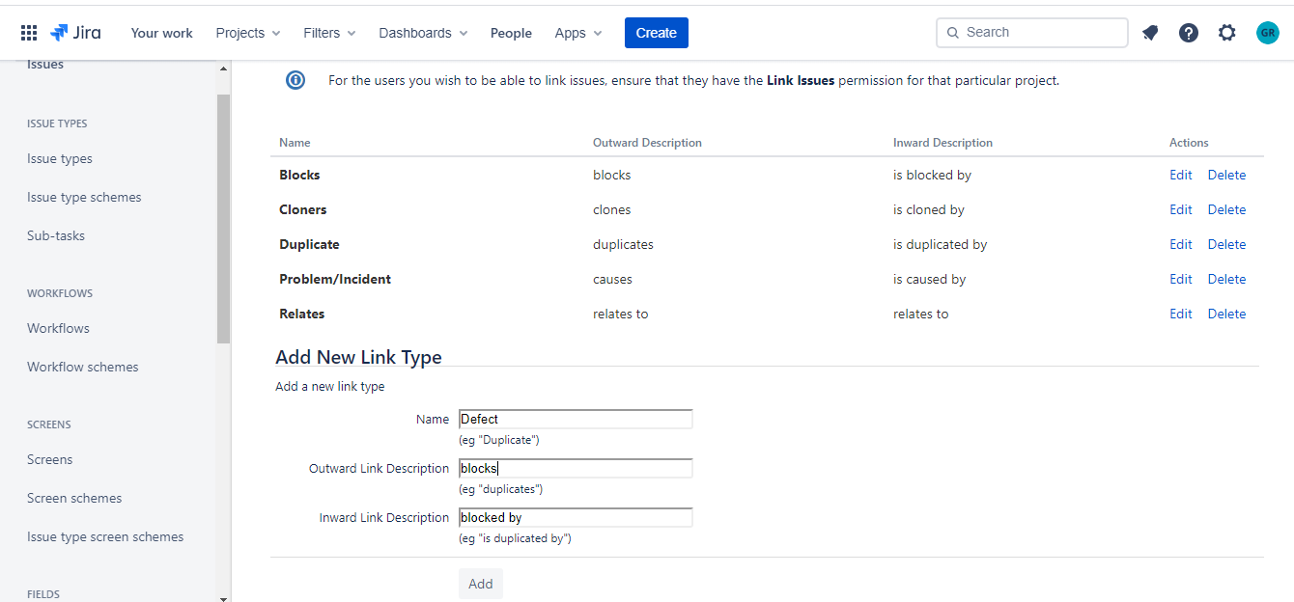
JIRA – Key Capabilities – Traceability
Traceability can be established between any two Issue Types

Slide 16
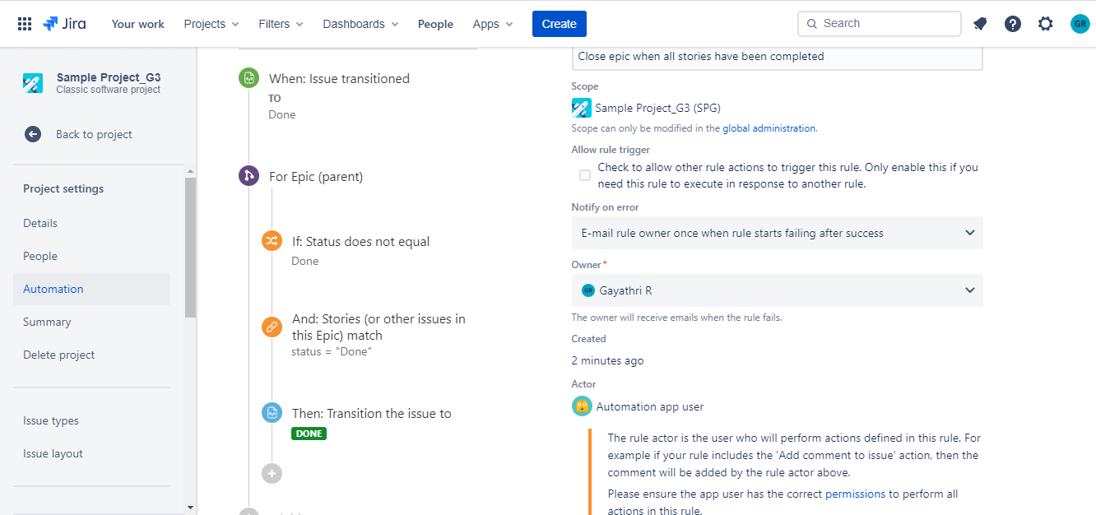
JIRA – Key Capabilities – Automation Rules
Automation Rules can be templatized and configured based on the Project need

Slide 17
Project Planning & Tracking – Scrum Board

Slide 18
JIRA – Key Capabilities – Plan & Work with Scrum Board
Scrum teams commit to ship working software through set intervals called sprints.
Scrum Backlog
Backlog Grooming
Prioritize the stories in the backlog
Version Mgmt.,
version is a set of features/fixes released together as a single update to the app.
Manage Epics
An epic captures a large body of work. Example: It's essentially a large user story that can be broken down into a number of smaller stories.
Unlike sprints, scope-change in epics is a natural aspect of agile development.
Estimate Stories (Story points, Size, etc)
Plan Workload
Task Management – Create sub tasks for the stories or issues as needed
Sprint Planning
Create Sprints
Add stories and subtasks to the sprint
Supports Active or Parallel Sprint
Assigning issues to versions helps you plan the order in which new features will be released to your customers.
Create Version and add issues to the version

Slide 19
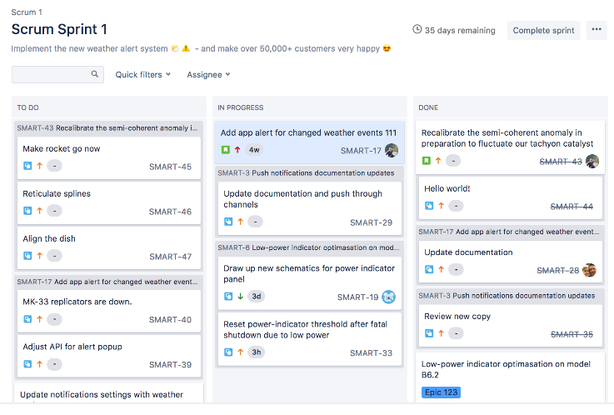
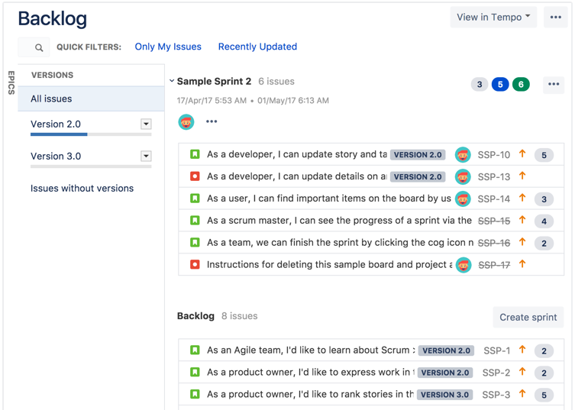
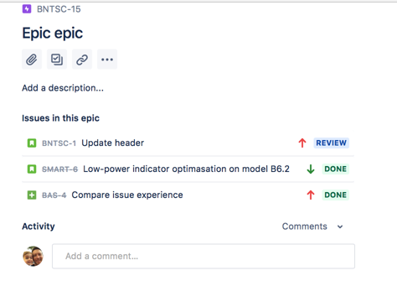
JIRA – Key Capabilities – Plan & Work with Scrum Board
Scrum Board
Backlog and Version Mgmt
EPIC → Story mapping

Slide 20
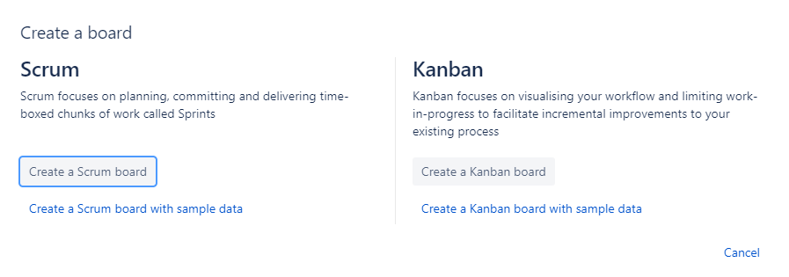
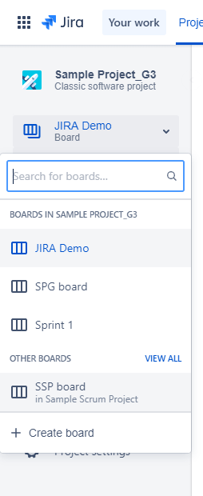
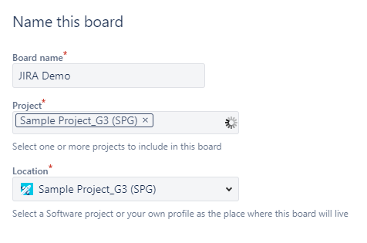
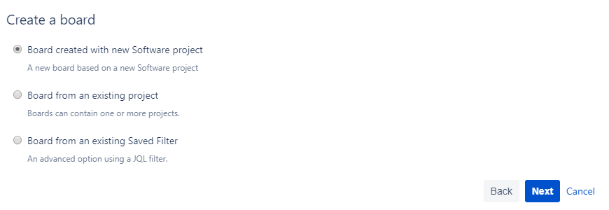

JIRA – Key Capabilities – Create a Scrum Board
2
Select the “Create a Scrum Board” button
Select the “Create Board” option from the left menu
1
4
Select the appropriate option to create a board with new JIRA project or to create a board to an existing JIRA Project
3
Provide a name to the board, select the project and click on “Create Board” option.

Slide 21
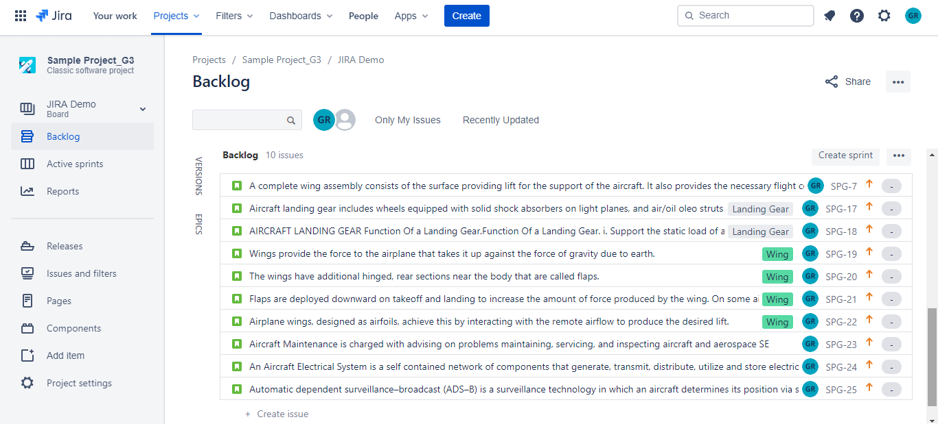
JIRA – Key Capabilities – Backlog Grooming
Add issues of various types and groom the backlog
Issue can be tagged to a component, Epic and Version

Slide 22
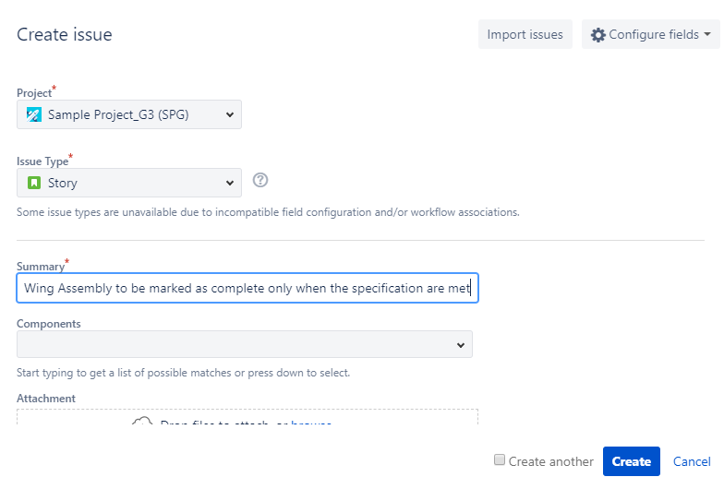
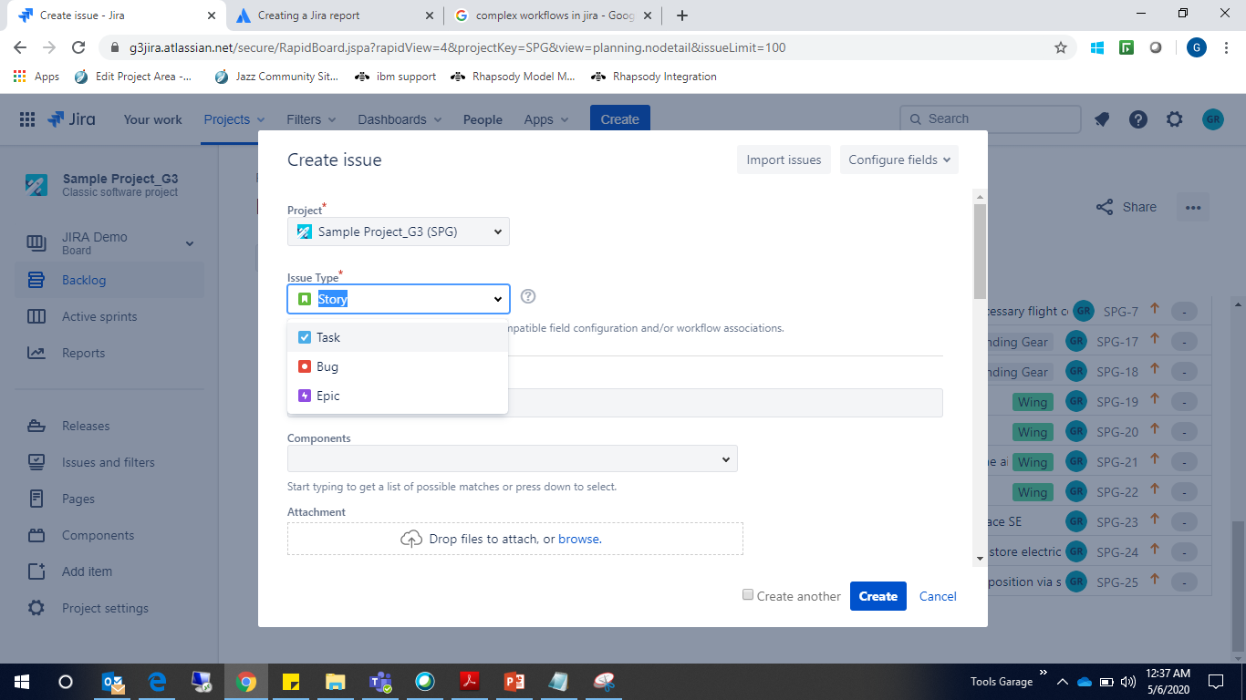
JIRA – Key Capabilities – Issue Creation
Select the create icon, a light box appears where user can create issue of any types
Select the appropriate issue type to create the issue.

Slide 23
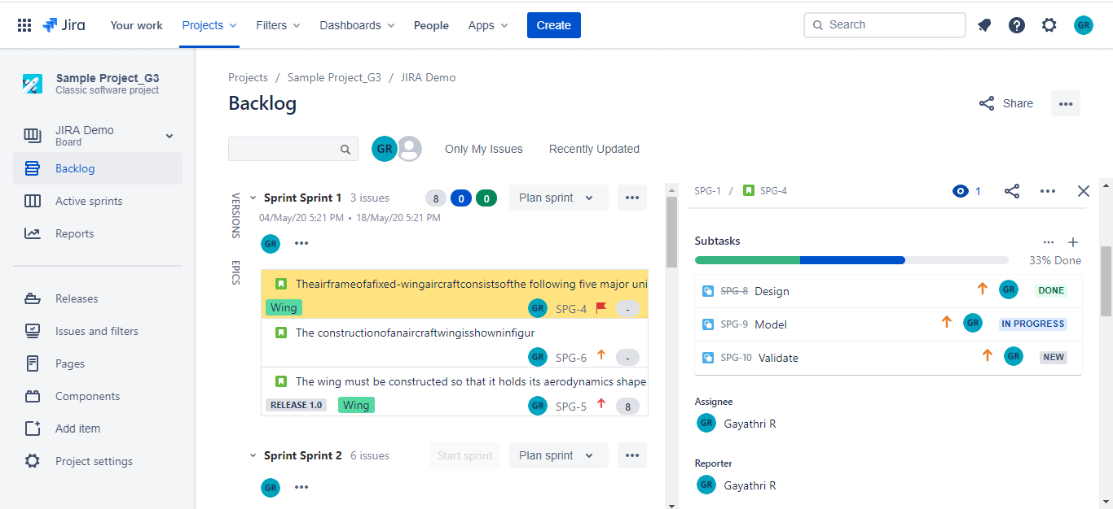
JIRA – Key Capabilities – Creating Sub Tasks
User can also create sub tasks for a story by clicking on the + icon and Plan and track the same

Slide 24
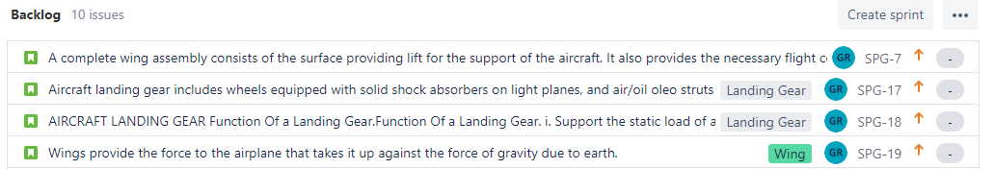
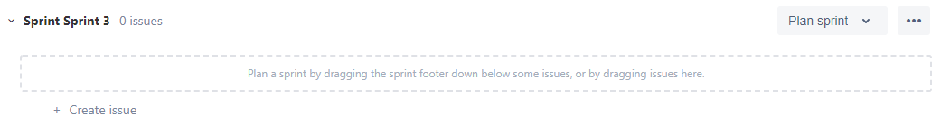
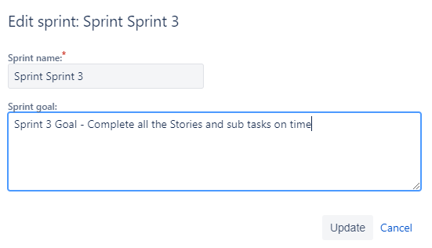
JIRA – Key Capabilities – Sprint Creation
Click the “Create Sprint” button on top of the backlog to create the sprint
Sprint gets created
Edit the sprint name and goal as needed

Slide 25
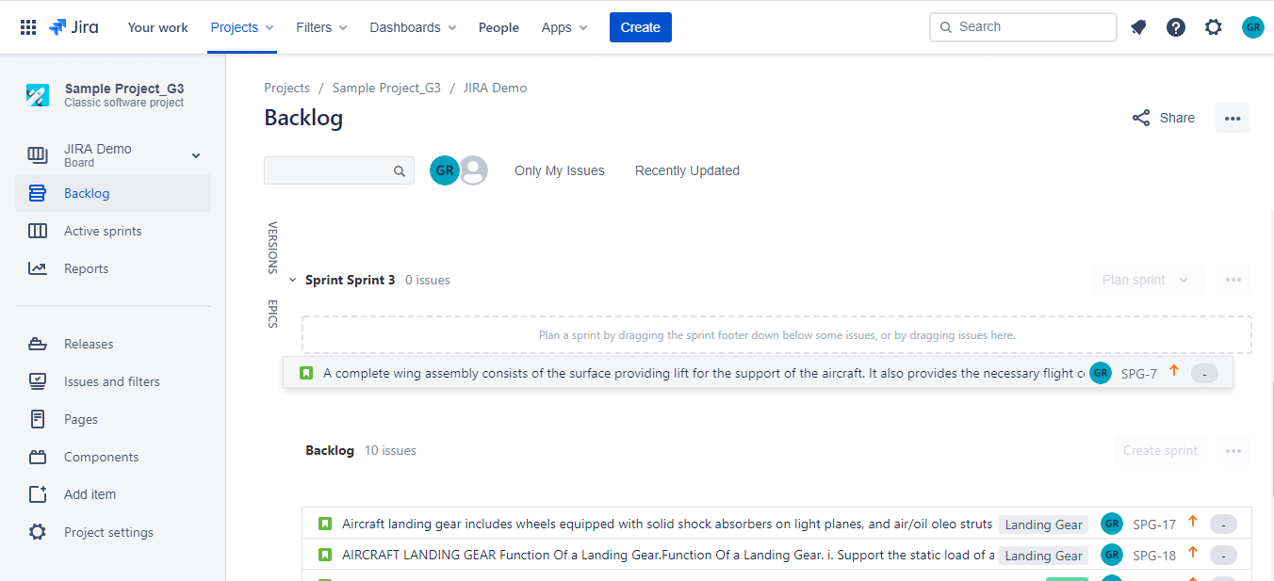
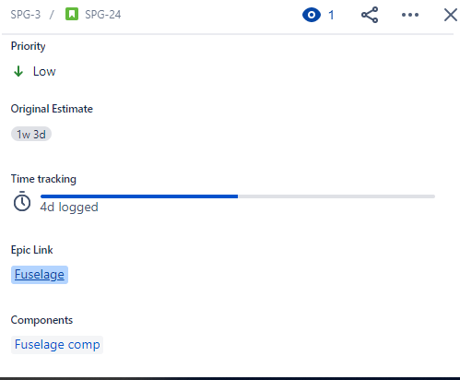
JIRA – Key Capabilities – Sprint Planning
Just drag and drop the issues from backlog to the appropriate Sprints.
Once the issue is added to backlog. Select the following for planning:
Assignee
Estimate
Epics
Components &
Versions

Slide 26
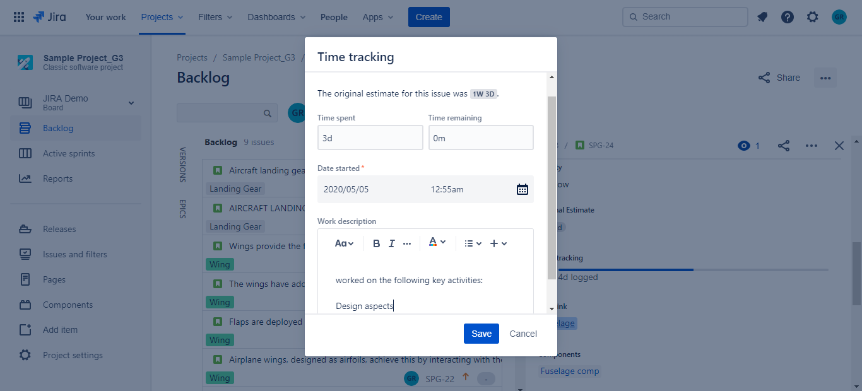
JIRA – Key Capabilities – Tracking
Assignee can provide the Time spent and time remaining for the issues assigned with the work description

Slide 27
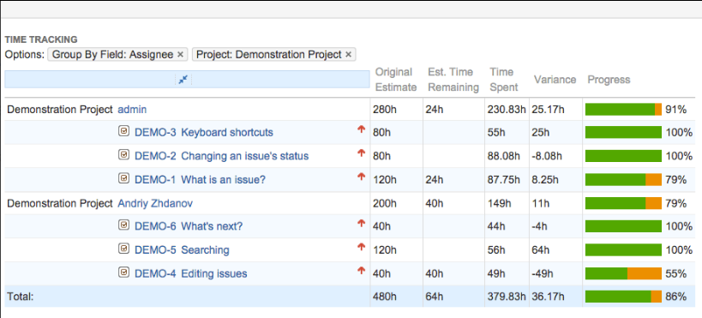
JIRA – Key Capabilities – Time Tracking
Time tracking lets your team record the time they spend working on issues.
Flexible time tracking and reporting of time spent on Projects, Epics or Initiatives broken down by Days, Users or Issue Statuses
Time Entry - single day view.
Timesheet - time spent on Issues by Days.
Time spent on Issues by Users.
Time spent on Issue in certain status.
Estimated vs Actual.
Time In Status - time passed in Status.
Resolution Time - time passed till Resolution.

Slide 28
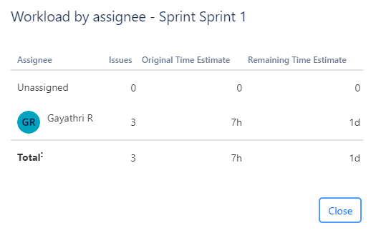
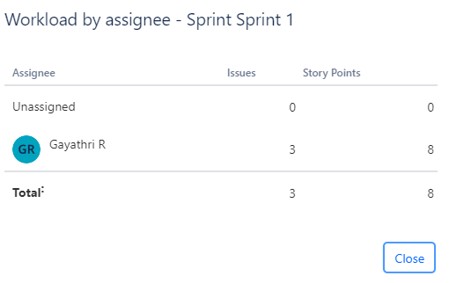
JIRA – Key Capabilities – Team Load
Work load of the team can be seen in two different ways either by Time estimate or by Story Points
Work load of the team by Time estimate
Work load of the team by Story Points

Slide 29
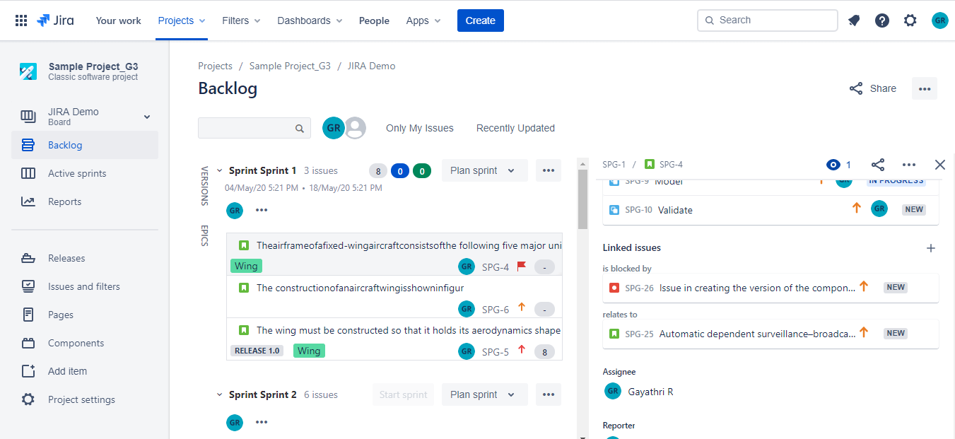
JIRA – Key Capabilities – Traceability
One Issue can be linked to another by using the “Link Issue” option.

Slide 30
Project Planning & Tracking – Kanban Board

Slide 31
JIRA – Key Capabilities – Plan & Work with Kanban Board
A Kanban board helps in visualizing your work, limiting work in progress, and maximizing efficiency(or flow).
Kanban Backlog
Backlog Grooming
Prioritize the stories in the backlog to rank it
Version Mgmt.,
Kanban boards do not require issues to be pre-assigned to versions. This is because Kanban is designed for a continuous flow of work, rather than set iterations.
Manage Epics
An epic captures a large body of work. Example: It's essentially a large user story that can be broken down into a number of smaller stories.
Every epic that has issues is shown as a swimlane on the Kanban board
Kanban Board
Kanban is based on the continuous delivery of work.
Add issues or stories to the Kanban board
Monitor issue progress and Release Issues
Task Management – Create sub tasks for the stories or issues as needed
Select issues for your team to work on as per the limits set
Set the constraints or limits for each state in the development process
On a Kanban board, you can choose to release a version at any point in time — the version will contain all issues that are complete at that time.

Slide 32
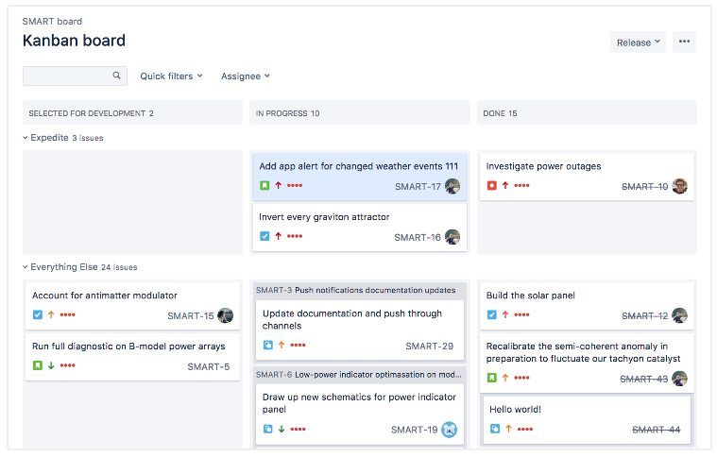
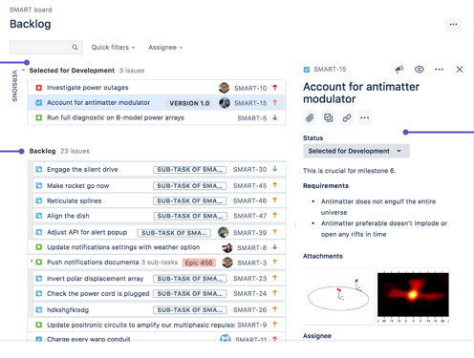
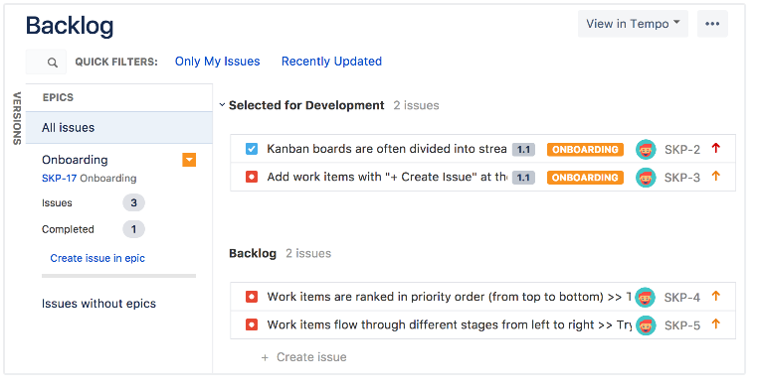
JIRA – Key Capabilities – Plan & Work with Kanban Board
Kanban Board
Backlog and Version Mgmt
EPIC → Story mapping

Slide 33
Reporting & Analytics

Slide 34
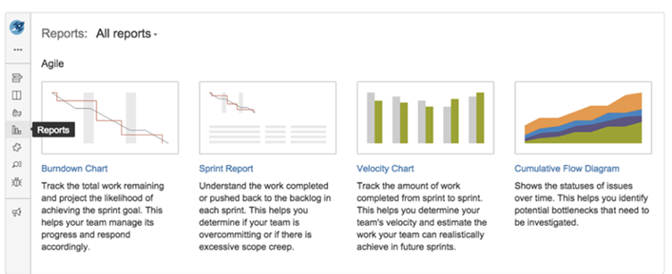
JIRA – Key Capabilities – Reporting and Analytics
Reports enable visibility of the situation of the application and offer project statistics throughout the entire lifecycle. Example: Burndown chart displays the actual as well as the estimated amount of work to be finished.
Role based Dashboard can be configured
Resolved vs. Created Issues Report
Resolution Time Report
User Workload Report
Single Level Group by Report
Version Report
Pie Chart Report
Average Age Report
Velocity Chart
Cumulative flow diagram
Sprint Report
Workload Pie Chart Report

Slide 35
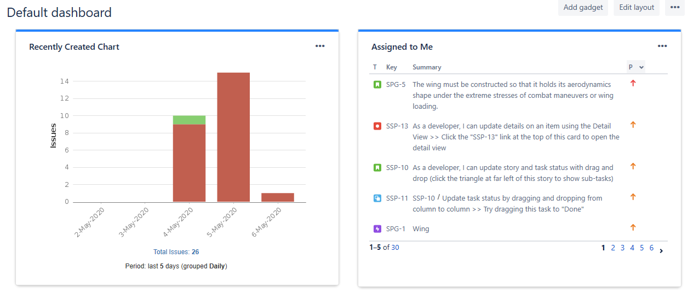
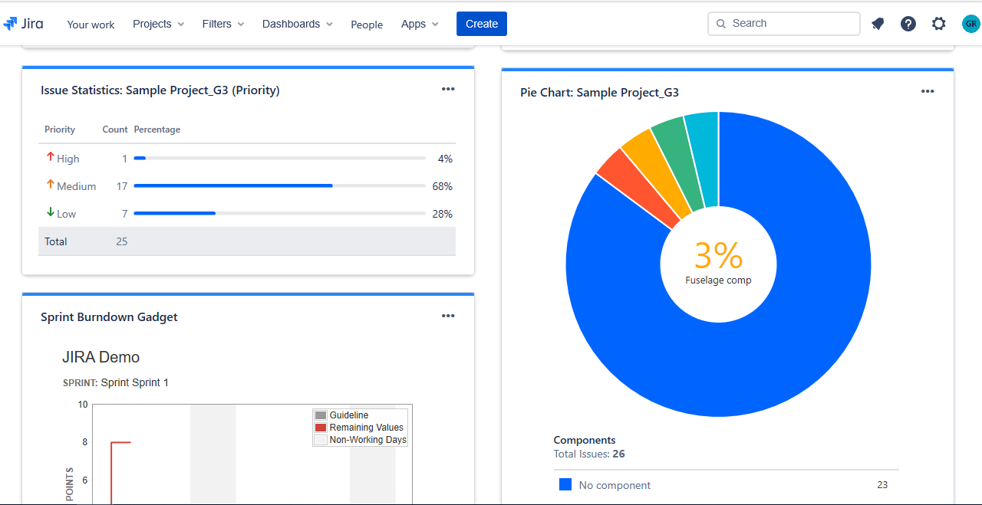
JIRA – Key Capabilities – Reporting and Analytics
There are lot of out of the box gadgets that are available for Dashboard configuration. Some are listed below:
Issues that are created recently for a specified period
Inbox – Showing the list of issues assigned to the logged in user
Issues by Priority – showing % of Completion
Issues by components defined
Sprint burn down chart

Slide 36
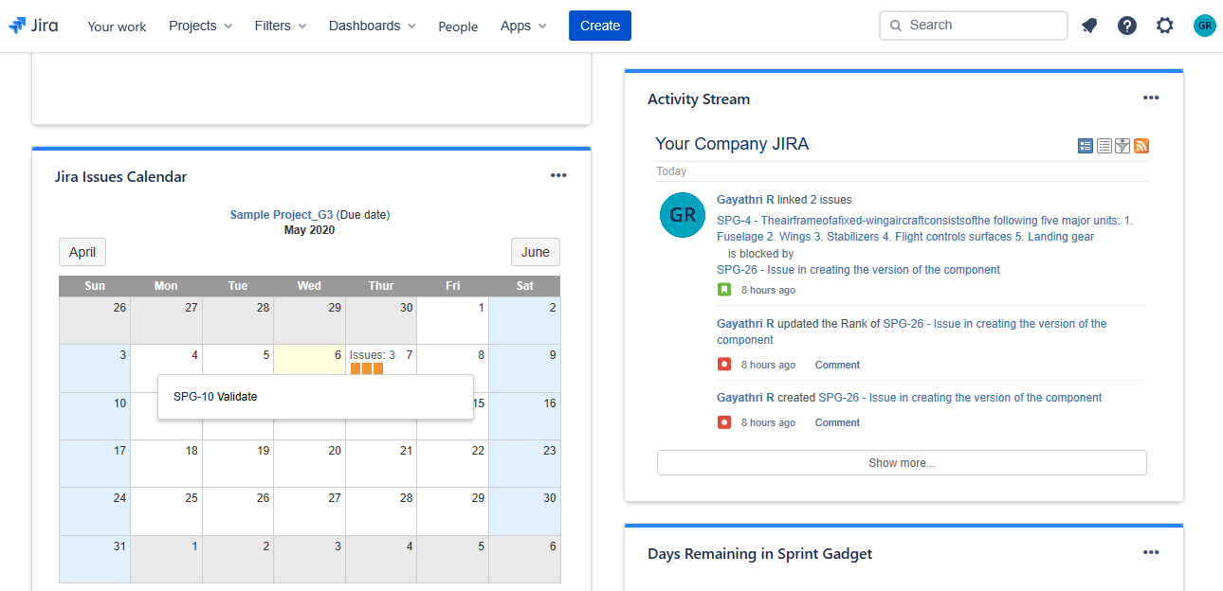
JIRA – Key Capabilities – Reporting and Analytics
There are lot of out of the box gadgets that are available for Dashboard configuration. Some are listed below:
Calendar view of issues that are due for a month / week as needed.
Activity stream of Issues – Based on recent activity

Slide 37
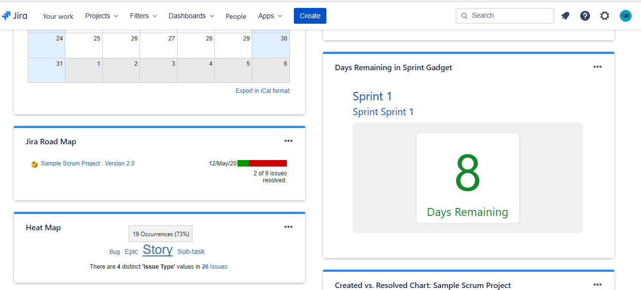
JIRA – Key Capabilities – Reporting and Analytics
There are lot of out of the box gadgets that are available for Dashboard configuration. Some are listed below:
Roadmap of the project by Version – Showcasing the release date the # of the issues pending. Issues details will be shown as drill down.
Days remaining for the sprints in the given project
Heat map of issues based on any attribute. Sample shown above is based on “Issue Type” attribute.

Slide 38
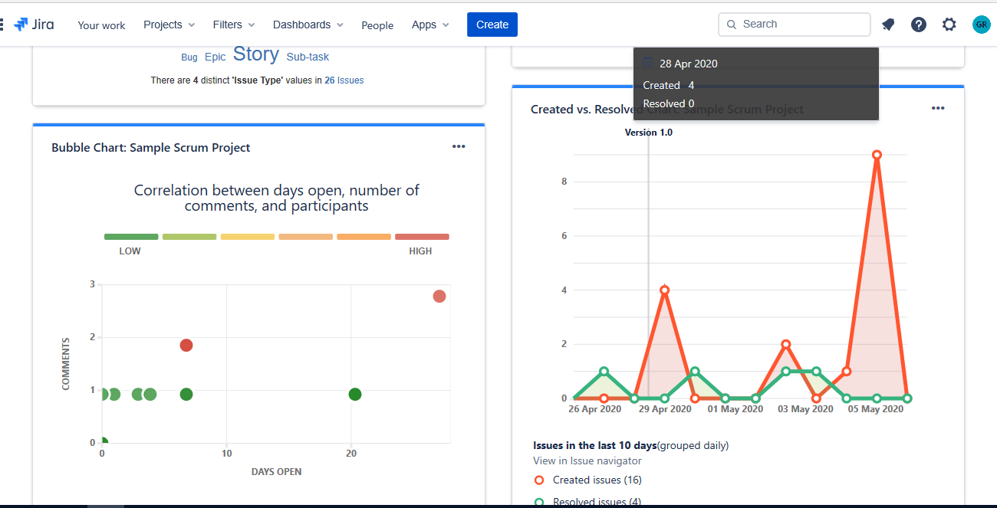
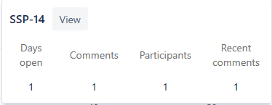
JIRA – Key Capabilities – Reporting and Analytics
There are lot of out of the box gadgets that are available for Dashboard configuration. Some are listed below:
Bubble chart showing the issue ageing, # of Comments and participants.
Graph showing the # of issues created Vs Resolved for a duration.

Slide 39
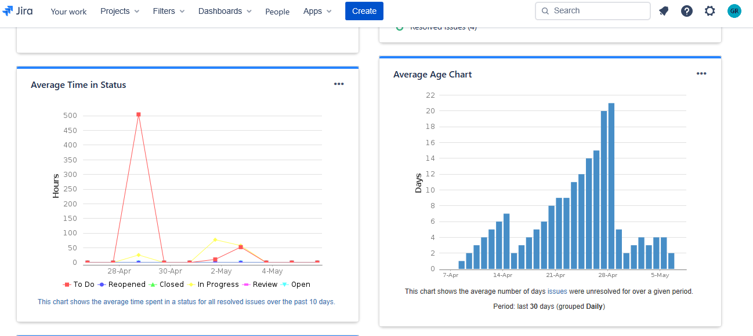
JIRA – Key Capabilities – Reporting and Analytics
There are lot of out of the box gadgets that are available for Dashboard configuration. Some are listed below:
Average time an issue is lying in a status
Average # of days issues were unresolved.

Slide 40

JIRA – Key Capabilities – Reporting and Analytics
There are lot of out of the box gadgets that are available for Dashboard configuration. Some are listed below:
Quick view of Agile Board
Average # of times an issue has Reopenend / Rejected.

Slide 41
JIRA – Key Capabilities – Other key features
Issue Linking – One issue can be linked to another to setup dependency or relationships
Issue Searching – filter based search; Filter can be saved, shared and subscribed and exported
Attachments and Screen shots
Ticklers / Notifications – Configurable email notifications and Ticklers can be defined
Email Integration to update an Issue
Bulk update of the issues

Slide 42

JIRA – Key Capabilities – Customization
End to End Issue type and Workflow configuration
API based customizations
Over 1000+ plugins for Integrations with other tools (open source and license based)
Report and Dashboard configuration

Slide 43
Resources Required for Hands on
Tool Name | JIRA Software (for Agile Project Mgmt)
Software Requirements | JIRA Software Version 8.8 JIRA cloud license plan is classified as Free; Standard and Premium (https://www.atlassian.com/software/jira/pricing) FREE – Access to free features; Online sandbox region; 2 GB file Storage; Free forever; supports 100 automation rule execution / month; but access to advanced permissions are limited. STANDARD – Standard trial is min $7 / user/month – can be extended to max 5000 users; 250 GB file storage space; 500 automation rule executions per month are supported PREMIUM - Standard trial is min $14 / user/month – can be extended to max 5000 users; unlimited file storage space; 1000 automation rule executions per month are supported Standalone version of JIRA SERVER: can be installed in any server; 10 users; 10 USD one time payment ; Multicore CPU; 2GB RAM with 7200 rpm or faster (for local setup only) . 30 day free trial is available DATA CENTER: 20400$ / year; 500 users; Option 3 hardware configuration suits this setup; 30 day free trial is available
Hardware requirements | Option 1: Basic: Multicore CPU; 2GB RAM with 7200 rpm or faster (for local setup only) Option 2: Minimum: Quad core 2GHz+ CPU; 6 GB RAM; 10 GB space Option 3: Advanced: 2 Intel(R) Xeon(R) CPU E5520 @ 2.27GHz (16 logical cores); 32GB of RAM. Inbuild DB: H2 Database suitable for evaluation purpose DB supported for Prod Installation: Azure SQL; Postgre SQL; My SQL; Oracle; SQL Server

Slide 44
Resources Required for Hands on
Tool Name | JIRA Software (for Agile Project Mgmt)
Dependencies | Java JDK/JRE
Other requirements | There is an inbuilt light weight db available within JIRA for basic use/evaluation.
Limitations | Option 1: Max 100 proj; 5000 issues; In cloud Software Free Trial - Access to advanced permissions are limited. In general, Symantec must be uninstalled from the server that you want to install Jira applications on, as it is known to dramatically reduce application performance.
*JIRA Service desk and JIRA core are other products
Note: Pl’s fill the information appropriately as per the tool that you are taking care; This information is considered only enabling hands on ; Pl’s include the version no of the software clearly

Slide 45
Thank You
Gayathri R

